Slide 1
Checklists for Authoring PowerShell Help
June Blender
Technical Evangelist
SAPIEN Technologies, Inc.
juneb@sapien.com
@juneb_get_help

Slide 2
CHECKLISTS PowerShell Help Authoring
Cmdlet Description Checklist
Parameters
Parameter Description Checklist
Parameter Attribute Checklist
Name parameter checklist
Path parameter checklist
ComputerName parameter checklist
Example Checklist
Synopsis Checklist
About Help

Slide 3
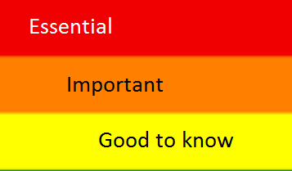
Description Checklist
Describes the cmdlet UI.
Explains the intended use.
Calls out important parameters.
Lists requirements (elevated)
Warns of likely errors
Version restrictions
New features

Slide 4
Parameter Description Checklist
Effect on cmdlet behavior
Content/format of valid parameter values
[Optional] Default values
[Optional] How to get parameter values
[Optional] Interaction with other parameters
Notes:
A good parameter description can save you lots of time and help you prevent errors.

Slide 5
Parameter Attribute Checklist:
Accept wildcard characters? Globbing
Default value

Slide 6
Name parameter checklist
Can I pick any name?
Must the named thing exist?
Are there any naming requirements? Best practices?
Must the name be unique (in a scope)?

Slide 7
Path Parameter Checklist
Directory or file?
If file, which type/extension?
Specify the extension, or just the name?
Must the directory/file exist?
If it exists, does the command overwrite?
Wildcards permitted?

Slide 8
ComputerName Parameter Checklist
Effect on cmdlet
Runs the command on a remote computer. The default is the local computer.
Format of parameter values
Type the NetBIOS name, an IP address, or a fully qualified domain name of one or more computers. To specify the local computer, type the computer name, a dot (.), or "localhost".
Restrictions/Technology issues
This parameter uses Windows PowerShell remoting. To enable remoting on the remote computer, use the Enable-PSRemoting cmdlet.
This parameter does not rely on Windows PowerShell remoting. You can use the ComputerName parameter even if your computer is not configured to run remote commands.

Slide 9
Example Checklist
Simple -> Complex
Use only mandatory parameters
Use optional parameters
Show parameter combinations
Real-world example

Slide 10
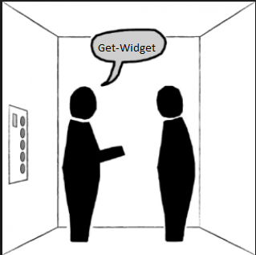
Synopsis Checklist:
Identify the technology (What kind of disk?)
Describe the action and outcome
If it's generic, say so. (Removes all events from the session.)

Slide 11
About Help Checklist
How do I use the cmdlets together?
Describe the technology (briefly, with references.)
In what order do I use them?
Is one a prerequisite?
Is one designed to pipe to another?
How do I use your module to solve a problem?
Examples

